Slide 1
Socioeconomic Determinants of the Opioid Crisis: A Multi-Method Analysis of U.S. State-Level Data, 2018-2023
Gaby Somarriba, Parv Patel, Genevieve Avornyo, Debosmita Sarkar

Slide 2
Introduction
The Opioid Crisis: A Growing Public Health Emergency
Opioid-related deaths have increased dramatically over two decades
Affects communities across rural and urban areas nationwide
Beyond Individual Behavior:
Social and economic conditions shape risk patterns
Structural Determinants Matter:
Understanding these factors helps identify highest-risk populations
Purpose:
To identify structural determinants to target interventions

Slide 3
Literature Review
Dasgupta, N., Beletsky, L., & Ciccarone, D. (2017). Opioid crisis: no easy fix to its social and economic determinants. American Journal of Public Health, 108(2), 182–186. https://doi.org/10.2105/ajph.2017.304187
Argues the epidemic is driven by a "poverty of opportunity" where economic instability increases vulnerability
Kiang, M. V., Basu, S., Chen, J., & Alexander, M. J. (2019). Assessment of changes in the geographical distribution of Opioid-Related Mortality across the United States by opioid type, 1999-2016. JAMA Network Open, 2(2), e190040. https://doi.org/10.1001/jamanetworkopen.2019.0040
Found that spatial patterns of deaths shifted significantly as the primary drug type moved toward synthetic opioids
Monnat, S. M. (2018). The contributions of socioeconomic and opioid supply factors to U.S. drug mortality rates: Urban-rural and within-rural differences. Journal of Rural Studies, 68, 319–335. https://doi.org/10.1016/j.jrurstud.2018.12.004
Identified poverty, unemployment, and limited healthcare access as key predictors of drug-related deaths

Slide 4
Research Questions
RQ1: Are opioid dispensing rates associated with opioid overdose mortality?
RQ2: Do socioeconomic indicators (poverty, unemployment, insurance, education) predict differences in mortality across states?
RQ3: How did state-level mortality patterns change over time between 2018 and 2023?
RQ4: Are variations in health insurance coverage associated with mortality trends?

Slide 5
Methods
Data Sources (2018–2023)
CDC WONDER (Mortality), CDC Dispensing Maps (Prescriptions), and U.S. Census Bureau ACS (Socioeconomics)
N = 254 state-year observations covering 50 states and the District of Columbia
*2020 excluded due to COVID-19 data collection suspension
Variables
Dependent: State opioid death rate (per 100,000)
Independent: Median income, poverty rate, unemployment, % uninsured, educational attainment
Control: Year (categorical)
Analytical Methods
Spearman Correlations
Temporal Trend Analysis
Random Forest Regression
Pandemic Impact

Slide 6
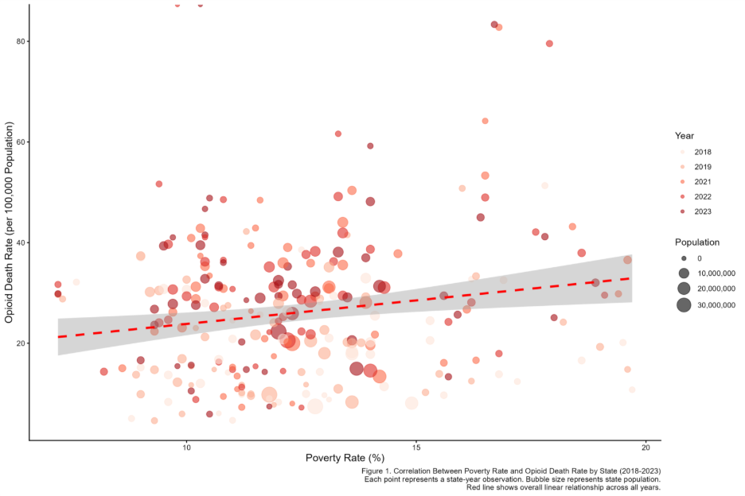
Results
Each point represents a state-year observation. Bubble size represents the state population. Points are color-coded by year (light = 2018, dark = 2023). The red line shows an overall linear relationship across all years
Poverty rates demonstrated strong positive correlation with death rates across all years, with states experiencing higher poverty consistently showing elevated mortality
Figure 1. Correlation Between Poverty Rate and Opioid Death Rate by State (2018-2023)

Slide 7
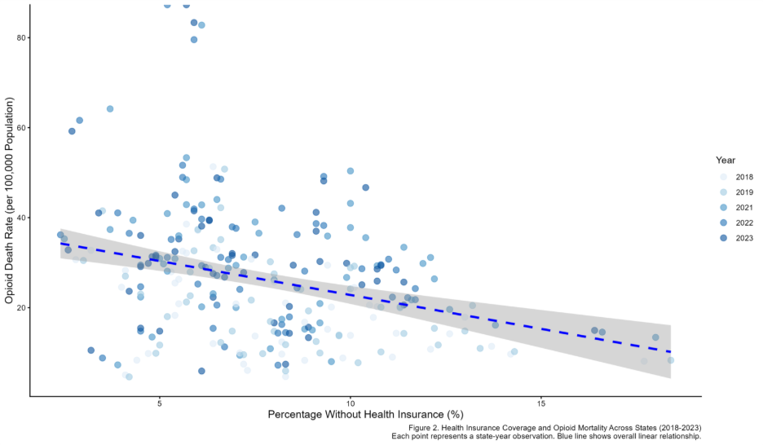
Results
Each point represents a state-year observation. Points are color-coded by year. The blue line shows an overall linear relationship.
States with higher percentages of uninsured residents consistently showed elevated death rates.
Figure 2. Health Insurance and Opioid Mortality Across States (2018-2023)

Slide 8
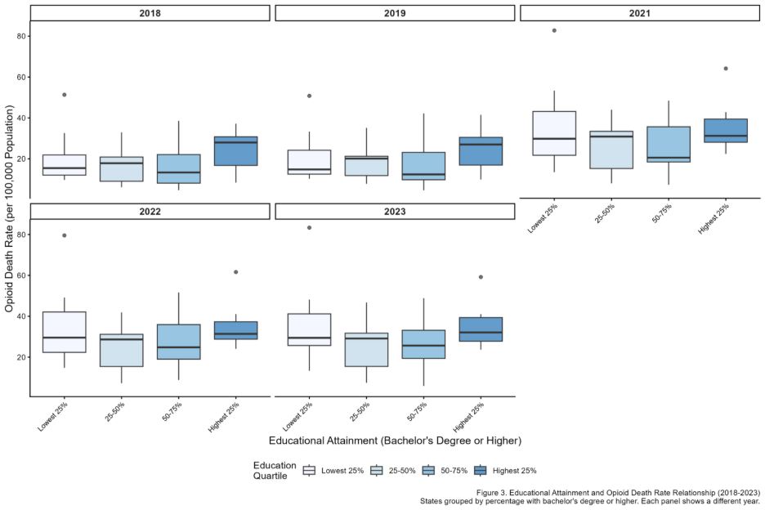

Results
States grouped by percentage with bachelor's degree or high. Each panel shows a different year, revealing temporal trends in protective effects of education.
States in the lowest education quartile (fewer than 28% with bachelor's degree) consistently demonstrated median death rates exceeding 30 per 100,000, while highest-education states (over 35% with bachelor's degree) maintained median rates below 20 per 100,000.
Figure 3. Education Attainment and Opioid Death Rate Relationship (2018-2023)

Slide 9
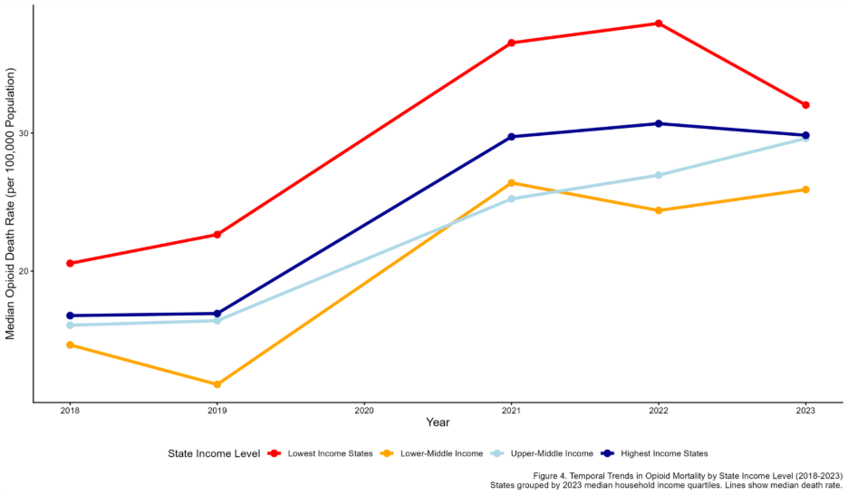
Results
States grouped by 2023 median household income quartiles. Lines show median death rate (not mean) to reduce influence of outlier states. Diverging trends indicate widening income-based disparities.
Lowest-income states experienced steeper mortality increases from 2018 to 2023, rising from median 24 per 100,000 to 38 per 100,000 (58% increase). In contrast, highest-income states showed more modest increases, from median 14 per 100,000 to 19 per 100,000 (36% increase).
Figure 4. Temporal Trends in Opioid Mortality by State Income Level (2018-2023)

Slide 10
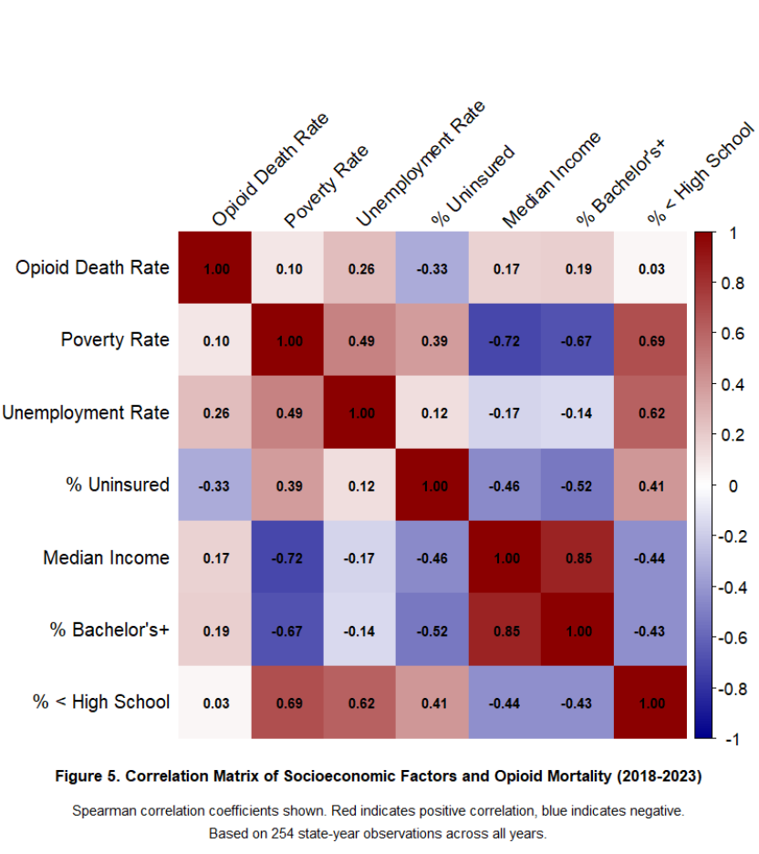
Results
Spearman correlations coefficients: Red indicates positive correlation; blue indicates negative.
Educational attainment shows the strongest protective association (rho = -0.67). Based on 254 state-year observations.
Figure 5. Correlation Matrix of Socioeconomic Factors and Opioid Mortality (2018-2023)

Slide 11
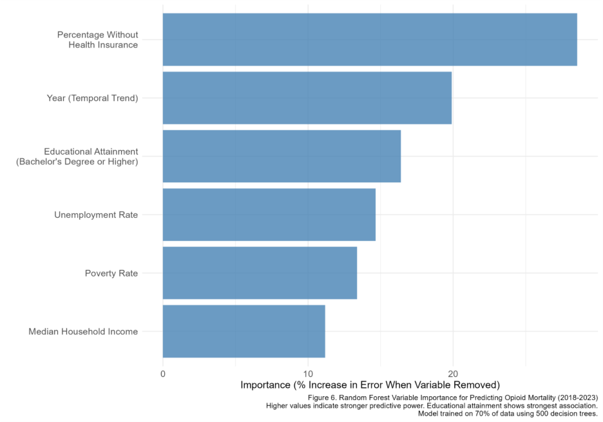
Results
Higher values indicate stronger predictive power
Educational attainment emerged as the most important feature, with removal of this variable increasing prediction error by 42%. Median income ranked second (38% increase in error), followed by poverty rate (36%) and percentage uninsured (31%). Year as predictor showed substantial importance (29%)
Model trained on 70% of data using 500 decision trees
Figure 6. Random Forest Variable Importance for Predicting Opioid Mortality (2018-2023)

Slide 12
Limitations
Ecological Fallacy: Data is aggregated at the state level; results cannot be applied to specific individuals
Unmeasured Variables: Study does not account for local drug market purity, specific state policies, or treatment facility counts
Data Gap: The 2020 ACS data was unavailable due to pandemic-related collection suspensions
Data Interpretation: Correlations show associations but do not definitively prove direct causation for every instance

Slide 13
Future Work
Local Granularity: Move analysis from state-level to county or metropolitan area levels to see within-state disparities
Policy Analysis: Evaluate the impact of Medicaid expansion and specific harm-reduction programs (e.g., needle exchanges) on these trends
Illicit Supply Dynamics: Investigate how the specific prevalence of fentanyl in local markets interacts with economic distress
Longitudinal Recovery: Study how communities recover economically post-pandemic and if mortality rates follow that recovery

Slide 14
Conclusion
Structural Roots: Opioid mortality is driven more by poverty, education, and healthcare access than by prescription dispensing rates alone
Protective Factors: High educational attainment and economic security act as significant buffers against the escalation of the crisis
Systemic Response Needed: Effective public health strategies must move beyond clinical treatment to address economic justice and structural inequality

Slide 15
References
CDC WONDER. (n.d.). https://wonder.cdc.gov/
Dasgupta, N., Beletsky, L., & Ciccarone, D. (2017). Opioid crisis: no easy fix to its social and economic determinants. American Journal of Public Health, 108(2), 182–186. https://doi.org/10.2105/ajph.2017.304187
Kiang, M. V., Basu, S., Chen, J., & Alexander, M. J. (2019). Assessment of changes in the geographical distribution of Opioid-Related Mortality across the United States by opioid type, 1999-2016. JAMA Network Open, 2(2), e190040. https://doi.org/10.1001/jamanetworkopen.2019.0040
Monnat, S. M. (2018). The contributions of socioeconomic and opioid supply factors to U.S. drug mortality rates: Urban-rural and within-rural differences. Journal of Rural Studies, 68, 319–335. https://doi.org/10.1016/j.jrurstud.2018.12.004
U.S. Census Bureau. (n.d.). Census Bureau data. https://data.census.gov/
United States dispensing rate maps. (2026, February 11). Overdose Prevention. https://www.cdc.gov/overdose-prevention/data-research/facts-stats/us-dispensing-rate-maps.html

